Slide 1


BIE Reporting
Spring 2025
June 18, 2025

Slide 2
Welcome
On behalf of the BIE CAO Assessment Team- Welcome to the BIE Spring 2025 Reporting Training.
Our Presenter from Pearson: Sam Boyle

Slide 3
Webinar Norms
Please type your name, email, role, and school in Chat.
Today’s training will be recorded and posted along with this PPT presentation to https://bie.mypearsonsupport.com/.
Please be sure to mute your microphone, if applicable.
Questions should be posted in Q&A.

Slide 4
Agenda
Reporting Overview
Preliminary Reports
Final Reports
Printed Reports
Resources & Contacts

Slide 5
Reporting Overview
Preliminary Report | Preliminary watermarked Individual Student Reports (ISRs) without growth data or Spotlight link
Final Report | Content Standards Roster* Reporting Category Roster* Demographic Performance Level Summary* Evidence Statement Analysis* Final Individual Student Reports (ISRs) with growth data & Spotlight link *CSV companion files available for download

Slide 6
Performance Level Descriptor Updates
Beginning with Spring 2024 reports, performance level descriptors (PLDs) were updated from 5 levels to 4, as indicated below:
  Level 4 – Exceeded Expectations (750-850)
  Level 3 – Met Expectations (725-749)
  Level 2 – Partially Met Expectations (700-724)
  Level 1 – Did Not Yet Meet Expectations (650-699)
This transition was informed by research study data and educator review, both of which suggest that four PLDs offer a clearer reflection of student achievement and preparedness for college and careers.

Slide 7
PLD FAQ
Are the BIE unified assessments less rigorous now than they have been?
  No. They are created to be as close to identical in terms of make-up and difficulty as have historically in place. While they do have some new culturally relevant content, they are strictly built to established blueprints and are also targeted to match historical statistical targets. So, the difficulty and rigor of the assessments aligns directly to what has been in place for BIE over the recent past.
How do the performance levels compare to previous performance levels?
  2024 & 2025 performance levels have transitioned to report scores according to four levels instead of five. This transition is part of an overall shift to have the BIE unified assessments in ELA and Math better reflect the needs of the BIE students it supports. From a score interpretation standpoint, level 3 is now the marker for Met Expectations moving forward and aligns with what previously had been designated as Approaching. To evaluate trend in relation to the PARCC/New Meridian five level system for historical comparisons, one can compare the Exceeded Expectation (level 4) results as a rough estimate.

Slide 8
PLD FAQ
Were educators involved in the process of the changes to the reporting of adjusted performance levels?
  Yes! Panels of BIE educators were directly involved in reviewing the PLDs and how they aligned within the four-level reporting system. Final performance level descriptions out of these meetings are part of the 2024 & 2025 score reporting.
Do scale scores from this year’s assessments compare to previous year’s scale scores?
  Yes. In no way do the adjustments made to PLDs reflect a change in the rigor of the assessments. Performance based on scale scores are still directly comparable across administrations (e.g., average scale scores for a given grade and subject). Any scale score across the reporting range reflects the same level of ability now as it has previously, within the same grade and subject.

Slide 9
PLD FAQ
Do student scale scores compare across grade levels?
  Not in a strict sense. Each grade level assessment is created with content aligned with that level’s standards and expectations, so scale scores are not directly comparable across the levels, even within the same subject area. There is some alignment in that the score reporting system is made consistent so that performance levels do reflect similar reference points.
What if I have questions about these or other BIE assessments?
  There are BIE points of contact that are available, or you may email (cao-assessments@bie.edu). Dr. Carmelia Becenti, Chief Academic Officer carmelia.becenti@bie.edu, Dr. Douglas Clauschee, Education Research Analyst douglas.clauschee@bie.edu, Mrs. Aurelia Shorty, Education Program Specialist, Assessments & Accountability aurelia.shorty@bie.edu.

Slide 10
Preliminary Individual Student Report (ISR)
Preliminary ISR PDFs have the same data and appear in the same format as the final reports except they have a preliminary watermark.
These preliminary reports are released before all Psychometric reviews have been completed, however student score results data does not typically change following these reviews.
Preliminary ISR PDFs will be replaced in ADAM by final ISRs once available.

Slide 11
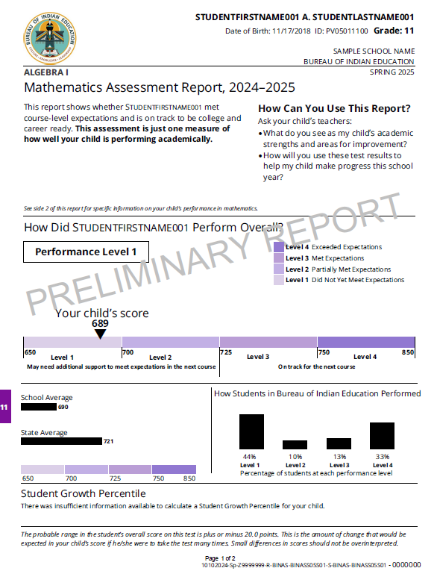
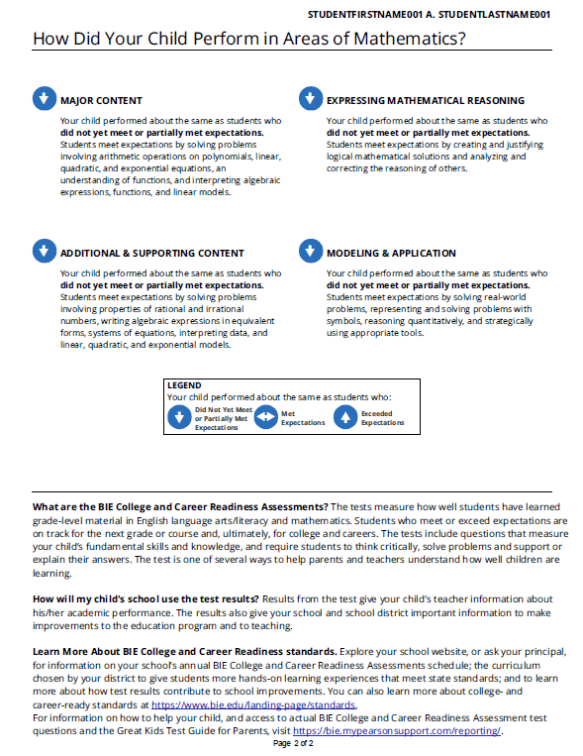
Preliminary Individual Student Report (ISR) PDF
No Spotlight link will be included on preliminary ISR PDFs
No growth data will be included on preliminary ISR PDFs

Slide 12
Preliminary Individual Student Report (ISR)
Preliminary ISRs are the first reports provided following the end of Summative testing.
  Available to view and download from Report Assets in ADAM as a PDF.
  Do not contain student growth data or Spotlight video report QR code or link.
As these reports are provided before all Psychometric review has been completed by Pearson, preliminary ISRs are subject to change.
  Significant changes to student score results are not to be expected.
More information on the content of ISRs will be provided later in this training.

Slide 13
Final Summative Reports
Content Standards Roster (PDF & CSV)
Demographic Performance Level Summary (PDF & CSV)
Evidence Statement Analysis (PDF & CSV)
Reporting Category Roster (PDF & CSV)
Individual Student Report (ISR) PDF with Growth data & Spotlight QR code
  2 printed copies per student per subject area

Slide 14
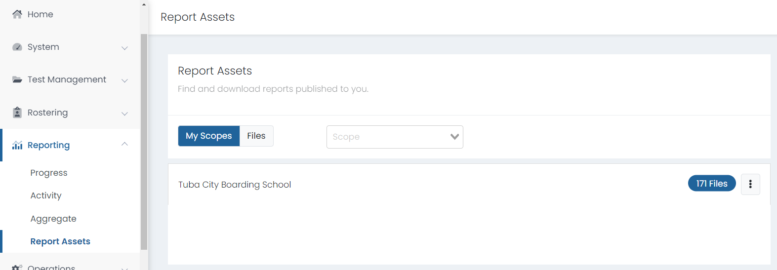
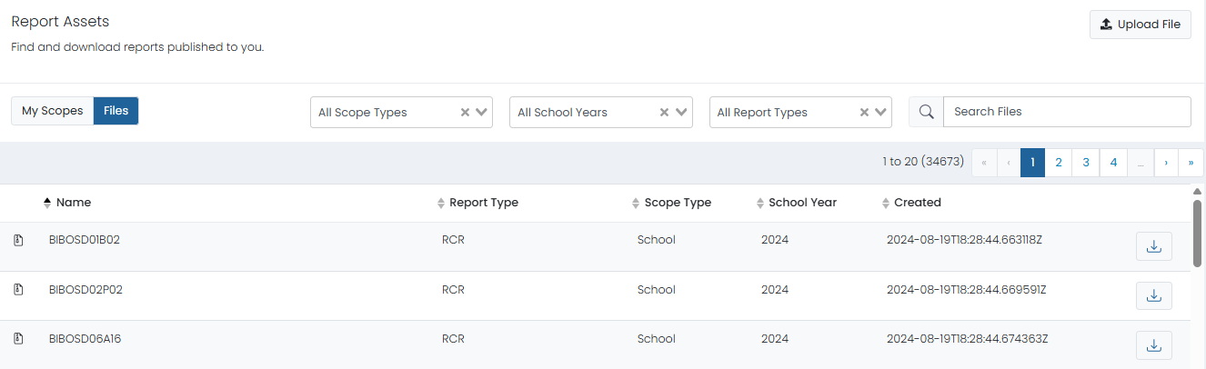
Accessing Summative Reports in ADAM
To access Summative reports, go to Reporting > Report Assets.
On the My Scopes tab, your files are grouped by organization.
On the Files tab, your files are listed alphanumerically. You can also drill down by year & report type.

Slide 15
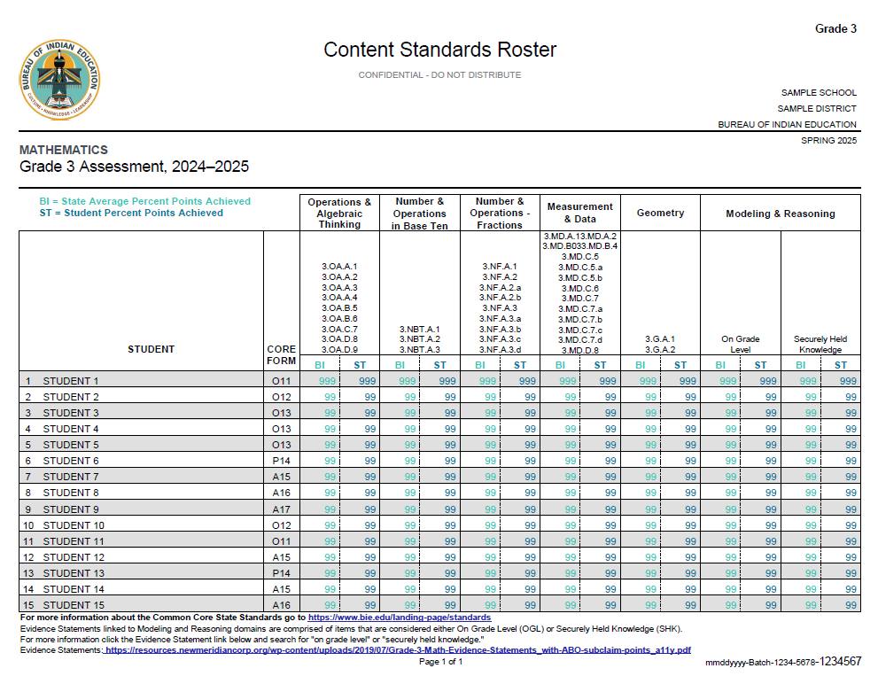

Content Standards Roster PDF
Student performance on each standard within the test is compared to overall performance at the Bureau level.

Slide 16
Content Standards Roster PDF
The Content Standards Roster displays the performance of students on individual standards within each content area of a given test.
The State Average Percent Points Achieved (the average of all Bureau students) and Student Percent Points Achieved (the individual student score at the school level) are provided.
This report displays whether each student exceeded, met, or did not yet meet the percentage points achieved at the Bureau level on each standard.

Slide 17
Content Standards Roster Companion File
The Content Standards Roster report has a CSV companion file that contains the information provided within the PDF in a data file format.
Companion file layouts will break down:
  CSV Column
  CSV Header Name
  Valid Values
Companion file layouts can be found at https://bie.mypearsonsupport.com/reporting/.

Slide 18
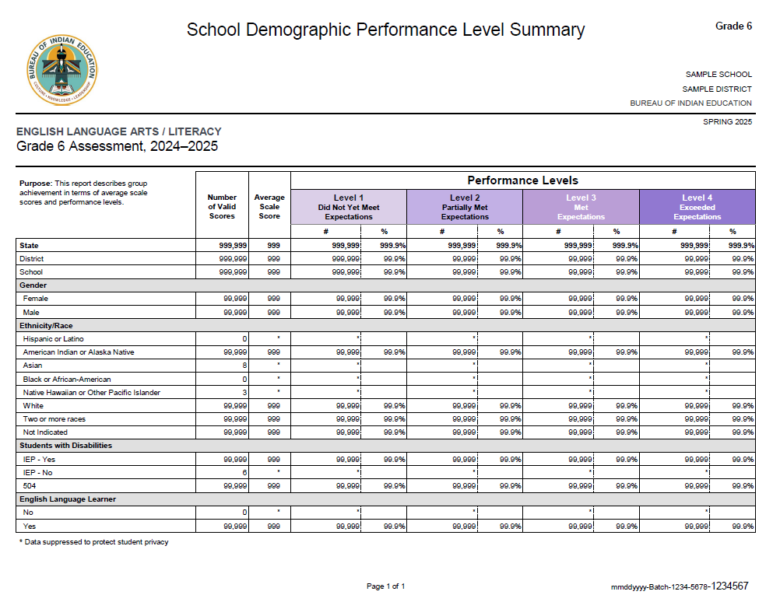
Demographic Performance Level Summary PDF
Performance levels are broken down by each demographic subgroup, which are indicated on the student record in ADAM.
If less than 10 students are represented within a given demographic subgroup, data will be suppressed.

Slide 19
Demographic Performance Level Summary PDF
The Demographic Performance Level Summary provides an overview of the performance levels for demographic subgroups.
Subgroups could include:
  Ethnicity/Race
  English Language Learner – Yes or No
  IEP – Yes or No
  Gender – Female or Male
The number of students in each subgroup is provided along with the performance level breakdown for that subgroup.
NOTE: If there are fewer than 10 students within a given subgroup, the performance level data for that subgroup will be suppressed to protect student personally identifiable information (PII).

Slide 20
Demographic Performance Level Summary Companion File
The Demographic Performance Level Summary report has a CSV companion file that contains the information provided within the PDF in a data file format.
Companion file layouts will break down:
  CSV Column
  CSV Header Name
  Valid Values
Companion file layouts can be found at https://bie.mypearsonsupport.com/reporting/.

Slide 21
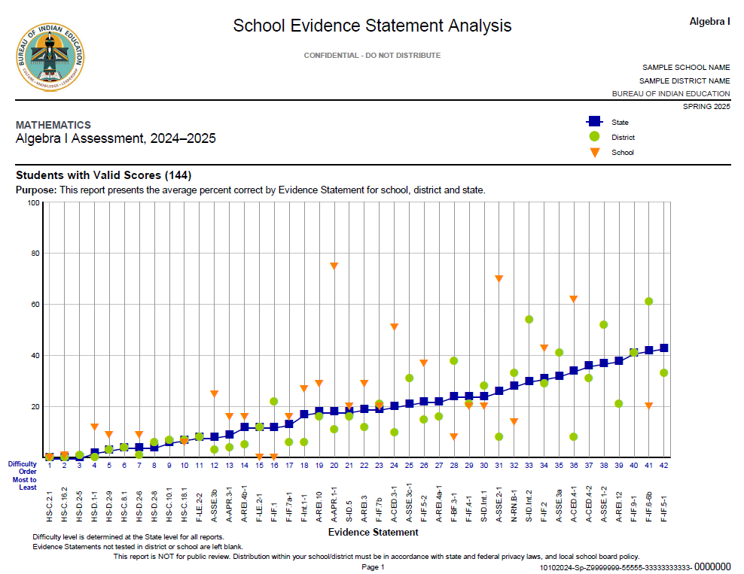
Evidence Statement Analysis PDF
Average percent correct for each evidence statement is plotted by State, District, & School.
Evidence statements are ordered from most to least difficult.

Slide 22
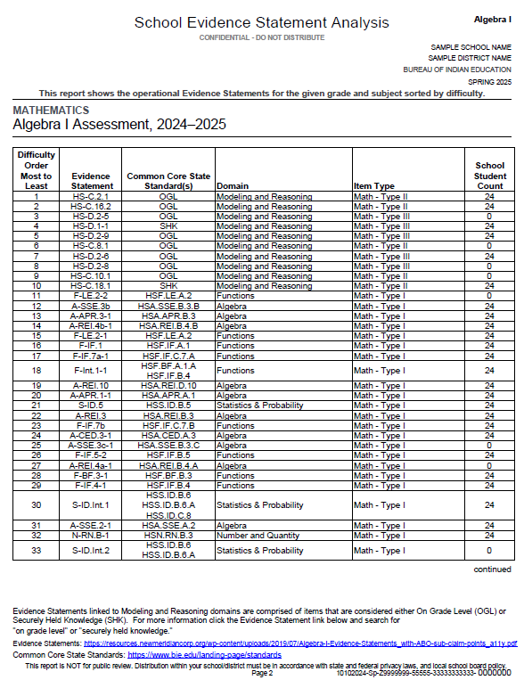
Evidence Statement Analysis PDF
School Student Count will vary depending on which Summative test form a student is assigned.

Slide 23
Evidence Statement Analysis PDF
The Evidence Statement Analysis displays the average percent correct for each evidence statement within a given test.
Breaks down students by School, District (BOS, NAV, TCS), and State (Bureau).
Orders evidence statements from most to least difficult.
Graphs student performance to compare performance on each evidence statement at the School, District, and State level.
  This allows schools to determine where their students are outperforming, matching, or underperforming within a particular evidence statement compared to their District or the Bureau at large.

Slide 24
Evidence Statement Analysis CSV Layout
The Evidence Statement Analysis report has a CSV companion file that contains the information provided within the PDF in a data file format.
Companion file layouts will break down:
  CSV Column
  CSV Header Name
  Valid Values
Companion file layouts can be found at https://bie.mypearsonsupport.com/reporting/.

Slide 25
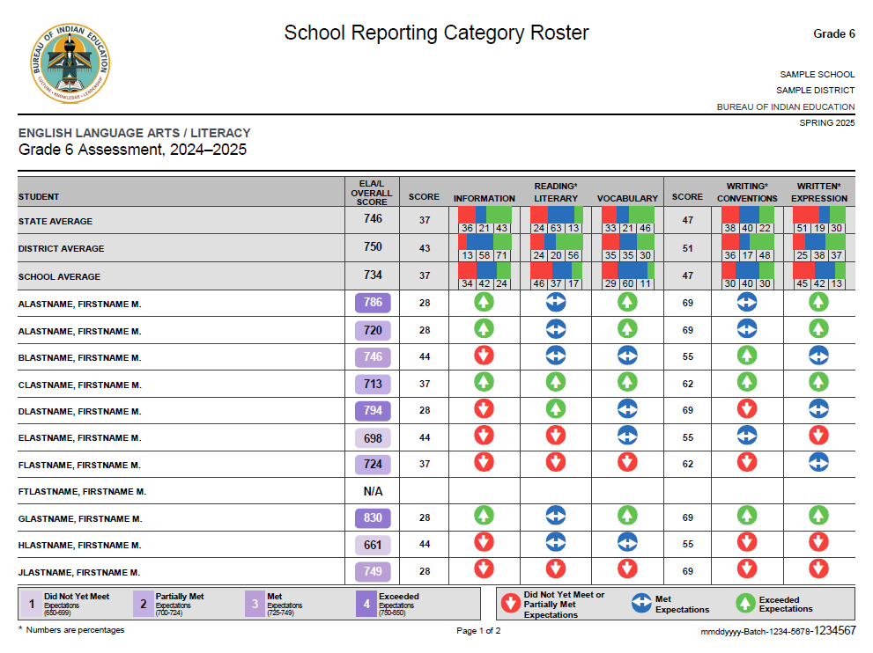
Reporting Category Roster PDF

Slide 26
Reporting Category Roster PDF
The Reporting Category Roster provides an overview, or “at-a-glance” picture, of the information provided in detail in the Individual Student Report (ISR).
The performance level of each student can be compared to the performance of students at the District level or the Bureau level.
An overall score for each subject area test is provided along with scores for each individual section of the test.
An Expectations Key displays whether a student Exceeded, Met, or Did Not Yet Meet or Partially Met Expectations on each area of the test.

Slide 27
Reporting Category Roster CSV Layout
The Reporting Category Roster report has a CSV companion file that contains the information provided within the PDF in a data file format.
Companion file layouts will break down:
  CSV Column
  CSV Header Name
  Valid Values
Companion file layouts can be found at https://bie.mypearsonsupport.com/reporting/.

Slide 28
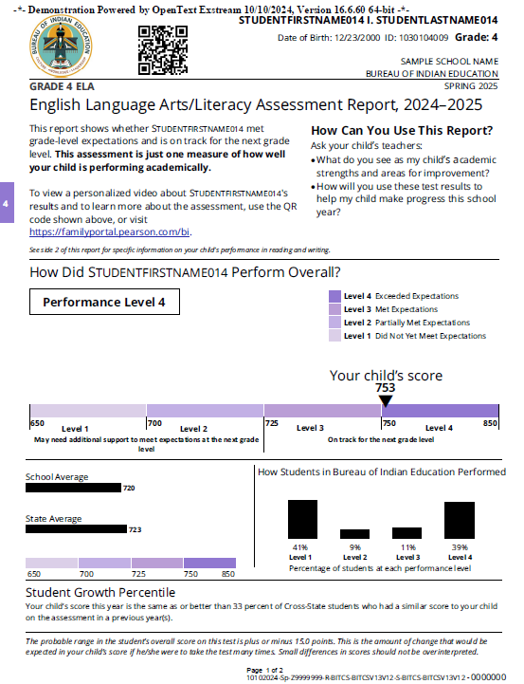
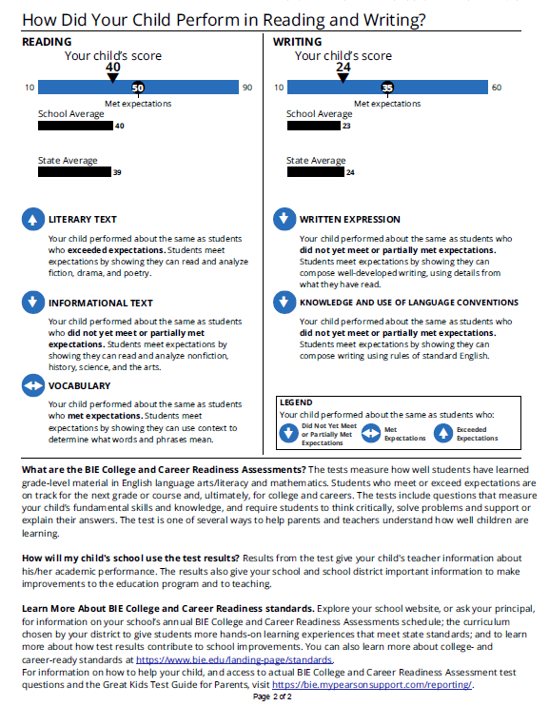
Final Individual Student Report (ISR) PDF
Spotlight QR code & Family Portal link included
Growth data included

Slide 29
Individual Student Report (ISR)
The ISR describes student performance by scale score, performance level, and subclaim performance indicators.
Page 1
  Spotlight personalized video report – QR code and URL
  Performance Level – includes School and State (Bureau) average
  Student Growth Percentile – if sufficient data is available to calculate growth, which requires multiple years of testing
Page 2
  Performance by Subclaim – indicates how the student performed relative to the overall performance of students who met or nearly met expectations for the content area

Slide 30
Printed Reports
Individual Student Report (ISR) – with growth data & Spotlight links
  2 ISRs per student/per content area
Parent Letter
  1 parent report per student
NOTE: Each school will receive 2 copies per content area of their student's Individual Student Report (ISR). The first item in the stack is the student roster, the next is ISR copy 1 (by grade), followed by ISR copy 2 (by grade).

Slide 31
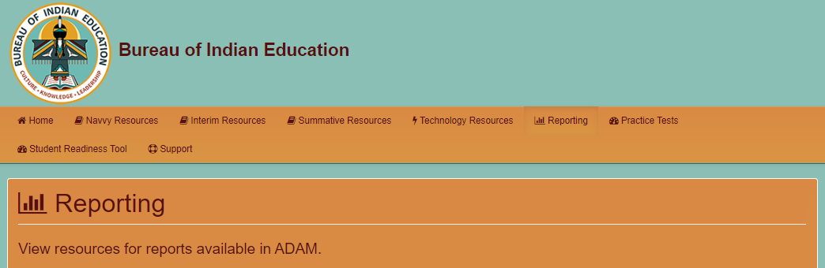
Report Resources
BIE Customer Support
1-833-302-9587
Monday – Friday
3:30 am – 4:30 pm (PT)
4:30 am – 5:30 pm (MT)
5:30 am – 6:30 pm (CT)
6:30 am – 7:30 pm (ET)
Materials on Support Page
Score Report Interpretation Guide
Performance Level Descriptors
Cut Scores
Companion File Layouts
https://bie.mypearsonsupport.com/reporting/

Slide 32
BIE Contacts
For general questions related to the ELA and Math Assessment:
Aurelia Shorty, Education Program Specialist (Assessment & Accountability), aurelia.shorty@bie.edu
For questions related to Assessment data files:
Dr. Rebecca Izzo, Research Analyst, rebecca.izzo@bie.edu
For questions related to the Assessment contract:
BJ Howerton, Contracting Officer’s Representative, bj.howerton@bie.edu

Slide 33
BIE Virtual Office Hours
More Questions?
Pearson will host Virtual Office Hours to address any questions about reports or the BIE assessments.
If you have questions or need any assistance, please join on Thursdays from 10:00 a.m. to 11:00 a.m. MT.
Office hours will start on June 26th.
Zoom link: https://pearson.zoom.us/j/99466831576?pwd=XDH2RHrg0NegVkgX8DVlDAOGAE48G6.1
  The Zoom link will also be added to the ADAM bulletin board and BIE | Home.

Slide 34
End of Presentation
Notes:
Closing Slide

